Slide 1
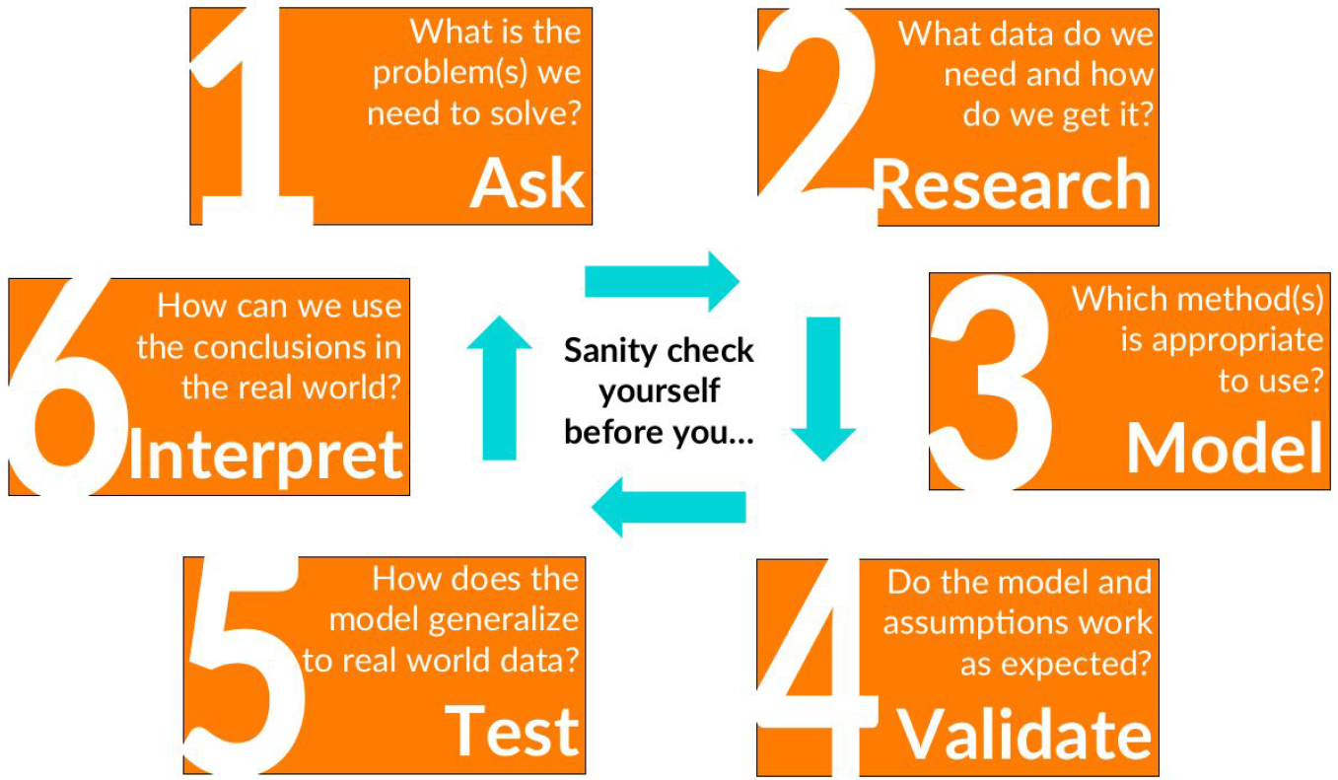
DSColab Spring 2018 Midway Capstone
Abhivyakti Sawarkar
FDA

Slide 2
Objectives
To explore drug-causality and predict high causality narratives the FAERS dataset

Slide 3



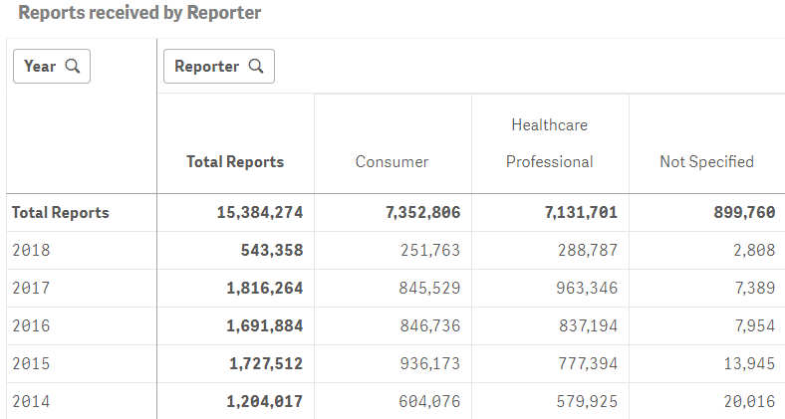
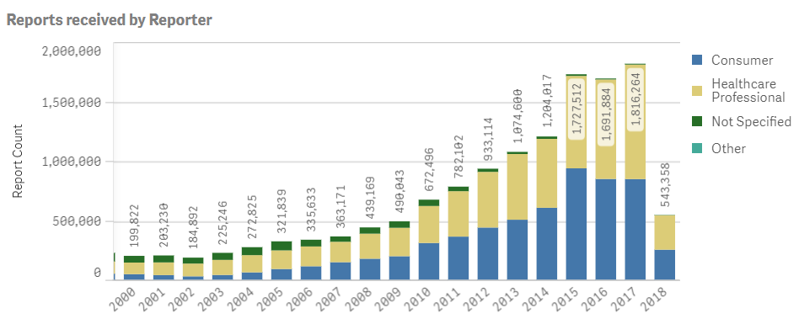
Describe your dataset
FDA’s Adverse Event Reporting System (FAERS) supports FDA's post-marketing safety surveillance program for all marketed drug and therapeutic biologic products.
It contains adverse event reports FDA has received from manufacturers as required by regulation along with reports received directly from consumers and healthcare professionals.

Slide 4
Describe your dataset
FDA’s Adverse Event Reporting System (FAERS) supports FDA's post-marketing safety surveillance program for all marketed drug and therapeutic biologic products.
It contains adverse event reports that FDA has received from manufacturers as required by regulation along with reports received directly from consumers and healthcare professionals.
FAERS contains >15 million narratives
Pilot set - curated and human feature engineered set of FAERS narratives of 298 rows and 207 columns parred down to 298 x 14 relevant columns.
Test set of 900 rows. Universe of 15M

Slide 5
What is the problem and who is the end user?
Safety signal reliability from post marketing safety surveillance requires confidence in “drug-causality” and hence prediction of high causality FAERS data (including narratives) is important.
Linguistic landscape for FAERS narratives remains unexplored.
End users:
Regulatory decision makers
Reviewers
Office of Surveillance & Epidemiology
Office of Translational Sciences

Slide 6
What are the variables of interest and how are they distributed?
Patients
Drugs, Adverse Events, Patient outcomes
Report Type
Reporter
Report Type | #
Industry reports | 273
Direct reports | 26
Reporter | #
Consumer | 106
MD | 81
Healthcare Professional | 59
Pharmacist | 23
Lawyer | 1
Registered Nurse | 1

Slide 7
Approach
Is your approach supervised or unsupervised?
Determine drug causality with manual curation of narratives to develop binary gold standard
Regression analysis with select variables (drug causality related to patient outcome, type of report, reporter profession, report type) to define relationship
Exploratory cluster analysis (unsupervised) of the narratives
Extract important features (patient, drug, ADE, reporter) with text mining and compare with human annotation
If supervised what is your target variable?
The “drug-causality”
The structure of the narrative

Slide 8
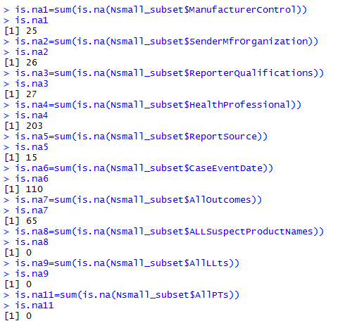
What challenges do you see?
Complex and messy dataset –
Multiple columns of capitalized character variables (drug, disease names) “:” separated within a cell – need to be separated
Acronyms – sometime multiple comma separated abbreviations in one cell
Abbreviated data
Missing data
Multiple entries in one cell
Unstructured data
ReporterQualifications
HP
MD
CON
MD
MD
CON
CON
MD
MD
CON
MD
CON
CON
CON
CON
CON
CON
PHARM
MD
ACTRAPID(PS):GLYBURIDE\METFORMIN:HUMULIN NOS
BLOOD CHOLESTEROL ABNORMAL:BLOOD GLUCOSE ABNORMAL:CHOLELITHIASIS
DE,HO,OT
But I must explain to you how all this mistaken idea of denouncing pleasure and praising pain was born and I will give you a complete account of the system, and expound the actual teachings of the great explorer of the truth, the master-builder of human happiness. No one rejects, dislikes, or avoids pleasure itself, because it is pleasure, but because those who do not know how to pursue pleasure rationally encounter consequences that are extremely painful. Nor again is there anyone who loves or pursues or desires to obtain pain of itself, because it is pain, but because occasionally circumstances occur in which toil and pain can procure him some great pleasure. To take a trivial example, which of us ever undertakes laborious physical exercise, except to obtain some advantage from it? But who has any right to find fault with a man who chooses to enjoy a pleasure that has no annoying consequences, or one who avoids a pain that produces no resultant pleasure?

Slide 9
Plan of action - Gantt chart
 | 06/28 - 07/06 | 07/07 - 07/13 | 07/14 - 07/20 | 07/21-End
Manual Curation & Data Transformation
Regression Analysis. Text Mining
Cluster Analysis
Final Results & Presentation

